Slide 1
Big Data
Guest Lecture at Westerdals

Slide 2


Who are we?
Thomas Almenningen
Data Analyst, Digital Analytics
Håkon Trømborg
Data Analyst, Digital Analytics

Slide 3


Who are we?
Thomas Almenningen
Analyst, Digital Analytics
Håkon Trømborg
Analyst, Digital Analytics

Slide 4
What are we going to talk about today?
1. What Big Data is
  Definition(s)
  Why now, and not earlier?
  Basic concepts
  Technologies
  Current state and trends
  How to take great selfies
2. Data visualization
  Definition
  Fundamentals
  Examples
  3. Techniques for data analysis
  Definition of Machine Learning
  Regression

Slide 5
What is Big Data?
Definition 1:
  Big Data technologies, like business intelligence, cloud computing and databases
  Visualization, such as charts, graphs and other displays of the data
  Techniques for analyzing data, such as A/B-testing, machine learning and natural language processing
  Source: McKinsey Global Institute report from 2011
Definition 2:
  Big data is a term for data sets that are so large or complex that traditional data processing applications are inadequate.
  Source: Wikipedia

Slide 6
Big Data: why did it start?
Technological advances
  Higher processor speeds
  Better memory
  Cheaper storage
More data being made and stored
  New data sources
  New storage technology
New and better algorithms and techniques
  Better hardware
  Research interest
  It started working

Slide 7
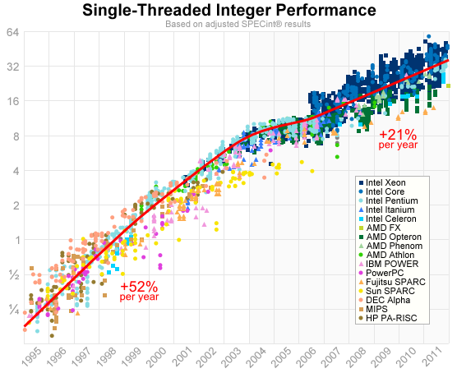

Slide 8
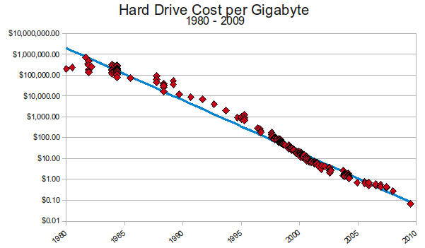

Slide 9
Big Data: why did it start?
Technological advances
  Higher processor speeds
  Better memory
  Cheaper storage
More data being made and stored
  New data sources
  New storage technology
New and better algorithms and techniques
  Better hardware
  Research interest
  It started working

Slide 10
https://pixelastic.github.io/ pokemonorbigdata/

Slide 11
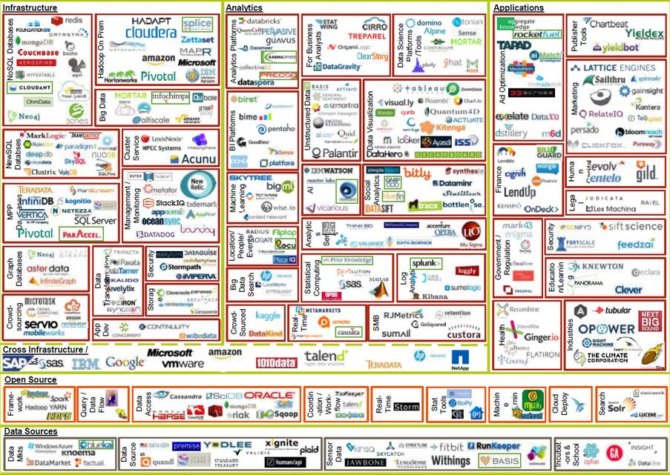

Slide 12
Basic concepts
Data sources
  Transactions(Business Systems)
  Social Media
  Unstructured Data(Text, images, video)
  Sensor Data (IoT)
  Personal data (FitBit, Sport trackers,
Characterizing Big Data (4V)
  Volume
    Scale of data
  Variety
    Different forms of data
  Veracity
    Uncertainity of data
  Velocity
    Analysis of streaming data

Slide 13
Technologies
First level text with bullets
  Second level text with bullets
    Third level text with bullets
      Fourth level text with bullets
        Fifth level text with bullets
First level text with bullets
  Second level text with bullets
    Third level text with bullets
      Fourth level text with bullets
        Fifth level text with bullets

Slide 14
Current state and trends
First level text with bullets
  Second level text with bullets
    Third level text with bullets
      Fourth level text with bullets
        Fifth level text with bullets
First level text with bullets
  Second level text with bullets
    Third level text with bullets
      Fourth level text with bullets
        Fifth level text with bullets

Slide 15
How to take great selfies
First level text with bullets
  Second level text with bullets
    Third level text with bullets
      Fourth level text with bullets
        Fifth level text with bullets
First level text with bullets
  Second level text with bullets
    Third level text with bullets
      Fourth level text with bullets
        Fifth level text with bullets

Slide 16
Title and two columns of text with bullets
First level text with bullets
  Second level text with bullets
    Third level text with bullets
      Fourth level text with bullets
        Fifth level text with bullets
First level text with bullets
  Second level text with bullets
    Third level text with bullets
      Fourth level text with bullets
        Fifth level text with bullets

Slide 17
Title and two columns with headings and bullets
First level text with bullets
  Second level text with bullets
    Third level text with bullets
      Fourth level text with bullets
        Fifth level text with bullets
First level text with bullets
  Second level text with bullets
    Third level text with bullets
      Fourth level text with bullets
        Fifth level text with bullets

Slide 20
Title and simple table example
Header 1 | Header 2 | Header 3 | Header 4
Column Title | 23.5 | 26.5 | 34.2
Column Title | 23.5 | 26.5 | 34.2
Column Title | 23.5 | 26.5 | 34.2
Column Title | 23.5 | 26.5 | 34.2
Column Title | 23.5 | 26.5 | 34.2
Column Title | 23.5 | 26.5 | 34.2

Slide 21
Bar chart example

